Slide 1
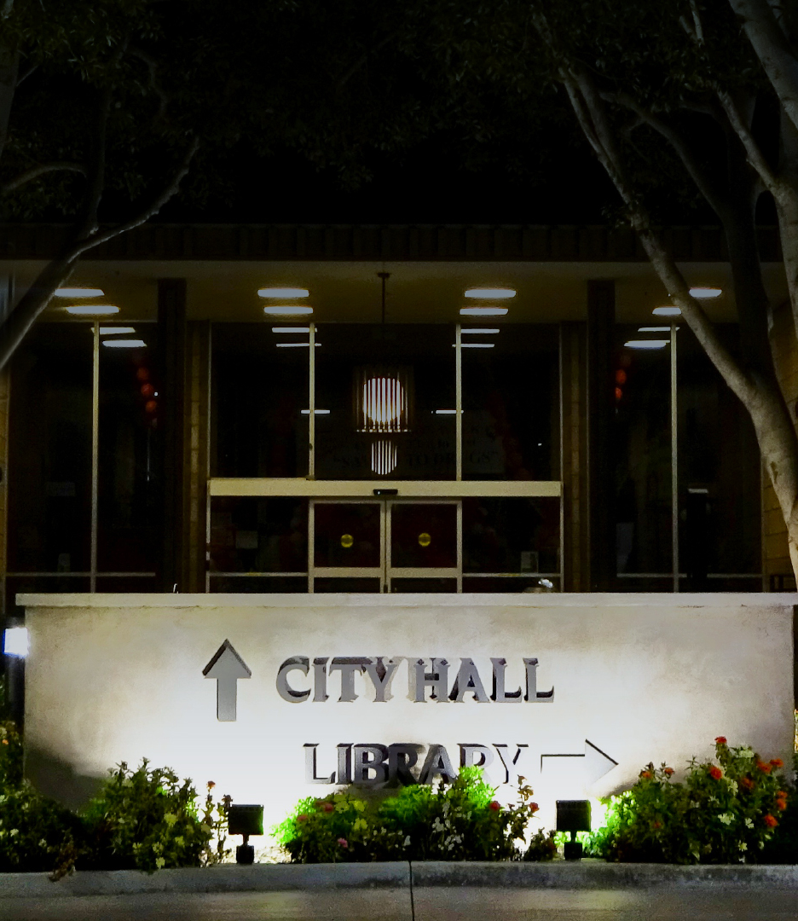


CITY OF SANTA FE SPRINGS
FY 2026-27 Budget Workshop #2
April 23, 2026
Notes:
v

Slide 2
Agenda
Opening Remarks by City Manager
FY 2024-25 Results
FY 2025-26 Budget Update
FY 2026-27 Proposed General Fund Budget
Department Summaries
Conclusion

Slide 3
Fiscal Year 2024-25 Results

Slide 4
FY 2024-25 Year-End Results
FY 2024-25 General Fund Year-End Actual (unaudited)

Slide 5
Fiscal Year 2025-26 Update

Slide 6
FY 2025-26 Revised Budget Update
Summary of Council-approved General Fund adjustments
Date | Description | Amount
10/7/25 | Additional appropriation from Art in Public Places | 1,884
11/5/25 | Personnel adjustments | 44,098
12/2/25 | Big 4 appropriation | 255,000
12/2/25 | Q1 personnel adjustments | 747,374
2/3/26 | Increased landscape contract | 106,211
3/3/26 | Citywide branding implementation | 280,000
3/3/26 | GVNC programmatic enhancements | 208,000
3/17/26 | Q2 adjustments (O&M: $440,000) (Personnel: $77,087) | 517,087
 | Total | $2,159,654

Slide 7
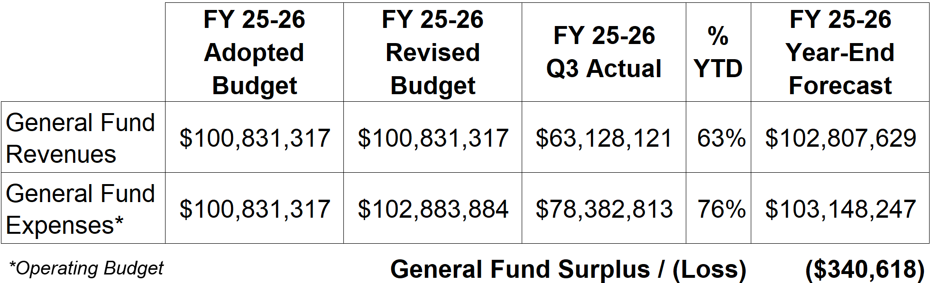
FY 2025-26 Q3 Forecast to Year-End
General Fund Q3 Summary and Forecast to Year-End

Slide 8
Fiscal Year 2026-27 Proposed Budget

Slide 9
UCLA Anderson Forecast - March 2026 Outlook
“UCLA economists describe California as developing a ‘bifurcated economy,’ where booming sectors such as AI and aerospace drive growth while industries like construction and retail expand more slowly — highlighting the challenge of translating innovation into broader job gains.”

Slide 10
UCLA Anderson Forecast
LA will recover from most disruptive effects of tariffs and deportation:
  Labor shortages and supply chain cost impacted manufacturing, construction, and agriculture
Recovery will start in late 2026 and growth will be slightly faster in 2027
  LA economic boost from 2026 World Cup, 2027 Super Bowl, and 2028 Olympics
Regional GDP (2.4% in 2025) is expected to slow to 1.3% in 2026
Unemployment: 5.5% in 2026, recover to 4.6% in 2027
March 2026 Fed Dot Plot Interest rate cut of 0.25% (25 bps): 3.50%-3.75%
Should have positive impact on housing & commercial real estate market

Slide 11
Economic Landscape
Less
control
Challenging Economic Factors
Flat revenues (Sales Tax, Franchise, UUT)
Pension (UAL) increases
Annual COLA/Step increase
Rising costs of contractual services
Expanding scope of services
Growing employee count
Offsetting Factors
Strong financial reserves
Focused economic development
Improved efficiencies
External Factors
Volatile Geopolitical Landscape
causes
Economic Uncertainty
More
control

Slide 12
Fiscal Year 2026-27 Proposed Budget
General Fund Revenues

Slide 13
General Fund Revenues
March to March General Fund Revenue Comparison

Slide 14
General Fund Revenues
FY 26-27 Projected General Fund Revenue Summary

Slide 15
General Fund Revenues
1
FY 26-27 Projected Revenue – General Revenues
1-Missing Feb/Mar payments; 2-First payment next year; 3-Includes April; 4,5-Biannual, next payment in May

Slide 16
General Fund Revenues
2
FY 26-27 Projected Revenue – Other Revenues

Slide 17
General Fund Revenues
3
FY 26-27 Projected Revenue – Program Revenues

Slide 18
General Fund Revenues
4
FY 26-27 Projected Revenue – Transfers/One-Time

Slide 19
Fiscal Year 2026-27 Proposed Budget
General Fund Expenses

Slide 20
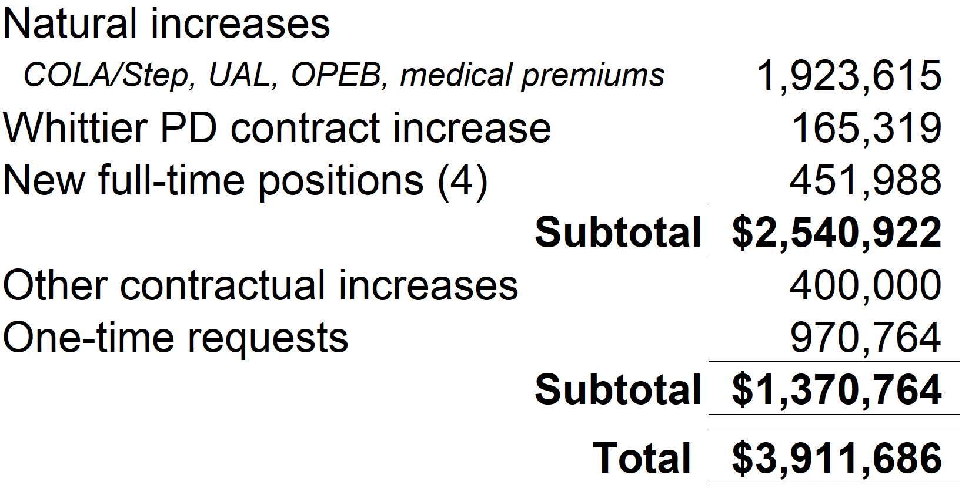
General Fund Expenses
Key expense assumptions: FY 26-27

Slide 21
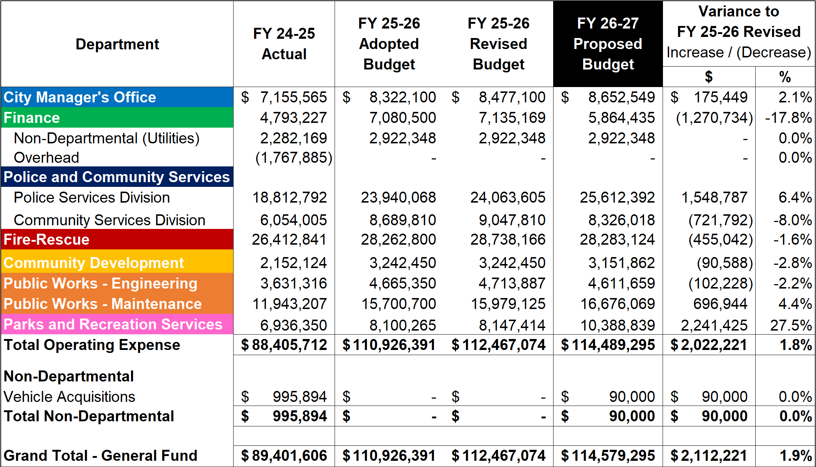
General Fund Expenses
FY 26-27 Projected
Expense Summary
*Community Services Division includes:
-Community Services Administration
-Library & Cultural Services
-Family & Human Services
-Transit Services
-Citywide Branding
*

Slide 22
General Fund Expenses
Expense Summary: Full-Time Labor
Department | FY 25-26 FTEs | Mid-Year Adjustment | Budgeted FTEs Removed | New FTE Request | FY 26-27 FTEs
City Manager’s Office | 18 | 1 | (4) |  | 15
Community Development | 8 |  | (1) |  | 7
Finance | 18 |  | (5) |  | 13
Fire-Rescue | 60 | 4 |  | 1 | 65
Parks and Recreation | 19 | 1 | (1) | 1 | 24*
Police and Community Services
Police Services Division | 21 | 8 |  |  | 29
Community Services Division | 30 |  | (4) | 2 | 24*
Public Works Engineering | 16 |  | (2) |  | 14
Public Works Maintenance | 37 |  | (5) |  | 32
General Fund Total FTEs | 227 | 14 | (22) | 4 | 223
Water Utility | 15 | 1 |  |  | 16
* 4 FTEs transferred from Community Services to Parks at mid-year

Slide 23
General Fund Expenses
Expense Summary: UAL, OPEB, and other Fixed Labor Costs

Slide 24
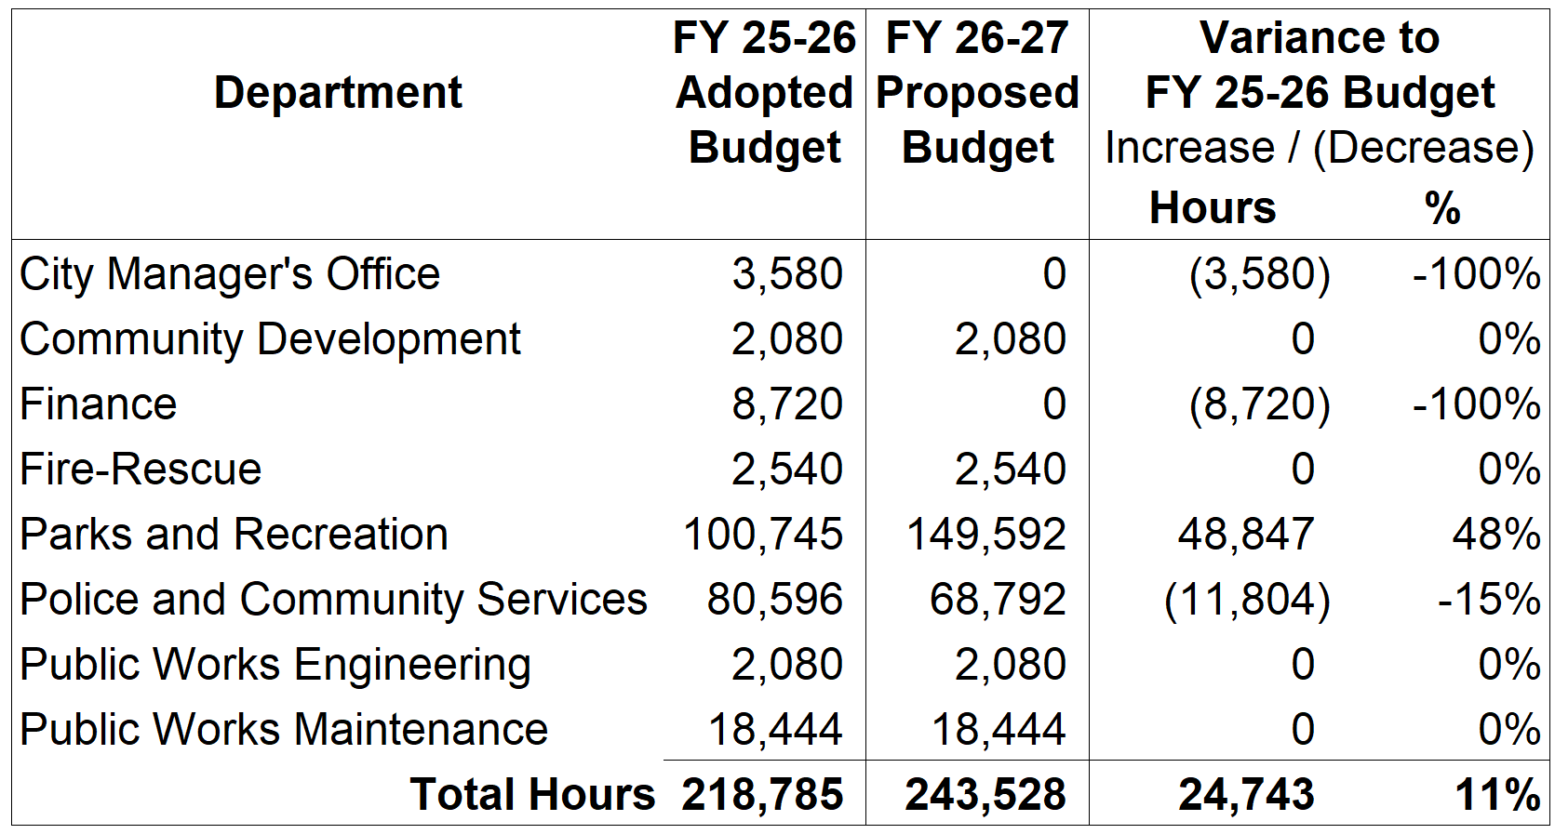
General Fund Expenses
Expense Summary: Part-Time Labor by Hours

Slide 25
General Fund Expenses
Expense Summary: 1-Time Requests
Department | Amount | Description
Community Development | $300,000 | Comprehensive zoning code update
Fire-Rescue | $233,000 | EMS startup costs
Parks and Recreation | $15,921 | Mobile devices
Police and Community Services
Police Services Division | $128,400 | Mobile devices and other equipment
Community Services Division | $293,443 | Branding efforts
General Fund Total | $970,764

Slide 26
Department Summaries

Slide 27
Department Summaries
City Manager’s Office
Community Development
Finance
Fire-Rescue
Parks and Recreation
Police and Community Services
Public Works Engineering
Public Works Maintenance
Water Utility

Slide 28
City Manager’s Office

Slide 29
City Manager’s Office
Proposed Budget Summary

Slide 30
City Manager’s Office
Full-Time Positions

Slide 31
Community Organization Support

Slide 32
Community Development

Slide 33
Community Development
Proposed Budget Summary
Note: Admin and Current Planning excludes reimbursable grant amounts (FY 25-26: $1,023,000; FY 26-27: $700,000)

Slide 34
Community Development
Full-Time Positions

Slide 35
Community Development
Part-Time Positions

Slide 36
Community Development
New and 1-time requests
Petroleum Engineering (Contractual Services)
Architectural Services (Contractual Services)
Funds for Appraisals and Title Reports (Contractual Services)
GovWell AI Operating System (Subscription)
I.CON West Conference (Travel/Meetings)
Completion of Comprehensive Zoning Code Update (Spring ‘27)

Slide 37
Finance

Slide 38
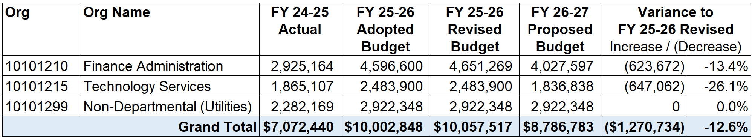
Finance
Proposed Budget Summary

Slide 39
Finance
Full-Time Positions

Slide 40
Finance
2 vacant Accounting positions
Budget: Implementation of Position Control
Water: Outsource billing (SGVWC)
IT: Internet & Telephone enhancements + consolidate & integrate software
Finance: Streamline vendor payments

Slide 41
Fire-Rescue

Slide 42
Fire-Rescue
Proposed Budget Summary

Slide 43
Fire-Rescue
Full-Time Positions

Slide 44
Fire-Rescue
Part-Time Positions

Slide 45
Fire-Rescue
New and 1-time requests
EMS Transportation Program
Emergency Management and Resilience Coordinator Position
Development of a Regional Drone Program for Emergency Response
Strengthening fire apparatus maintenance capabilities to improve fleet reliability and reduce downtime

Slide 46
Parks and Recreation

Slide 47
Parks and Recreation
Proposed Budget Summary

Slide 48
Parks and Recreation
Full-Time Positions

Slide 49
Parks and Recreation
Part-Time Positions

Slide 50
Parks and Recreation
New and 1-time requests
New Lifeguard position
Expanded Aquatics program and operations
New Winter Wonderland at Heritage Park
Transition of Community Services Heritage Park and Mariachi Class
Transition of Community Services events (ArtFest, summer concerts (6), Las Posadas)
Transition of Art in Public Places budget (including Rose Parade)
New 80s Event
New ribbon cutting ceremonies

Slide 51
Police and Community Services

Slide 52
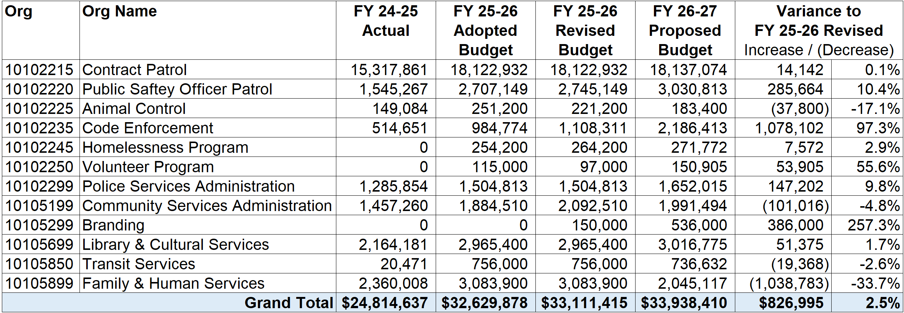
Police and Community Services
Proposed Budget Summary - Combined

Slide 53
Police and Community Services
Police Services Division

Slide 54
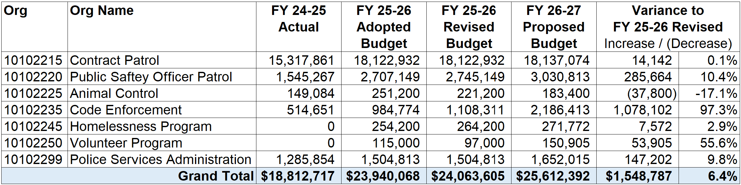
Police and Community Services
Police Services
Division
Proposed Budget Summary – Police Services Division

Slide 55
Police and Community Services
Police Services
Division
Full-Time Positions

Slide 56
Police and Community Services
Police Services
Division
Part-Time Positions

Slide 57
Police and Community Services
Police Services
Division
New and 1-time requests
Expanded Public Safety Officer Patrol operations
Expanded Code Enforcement operations
Whittier Police Contract increase, MOU increase
Purchase of (5) radios and (2) drones
Contractual services increased by $385K for illegal dumping removal services, contracted City prosecutor, fencing/boarding services and illegal dumping cameras repair/replacement
Purchase of (1) Code Enforcement truck
Overall O&M increase due to increased programs/services

Slide 58
Police and Community Services
Community Services Division

Slide 59
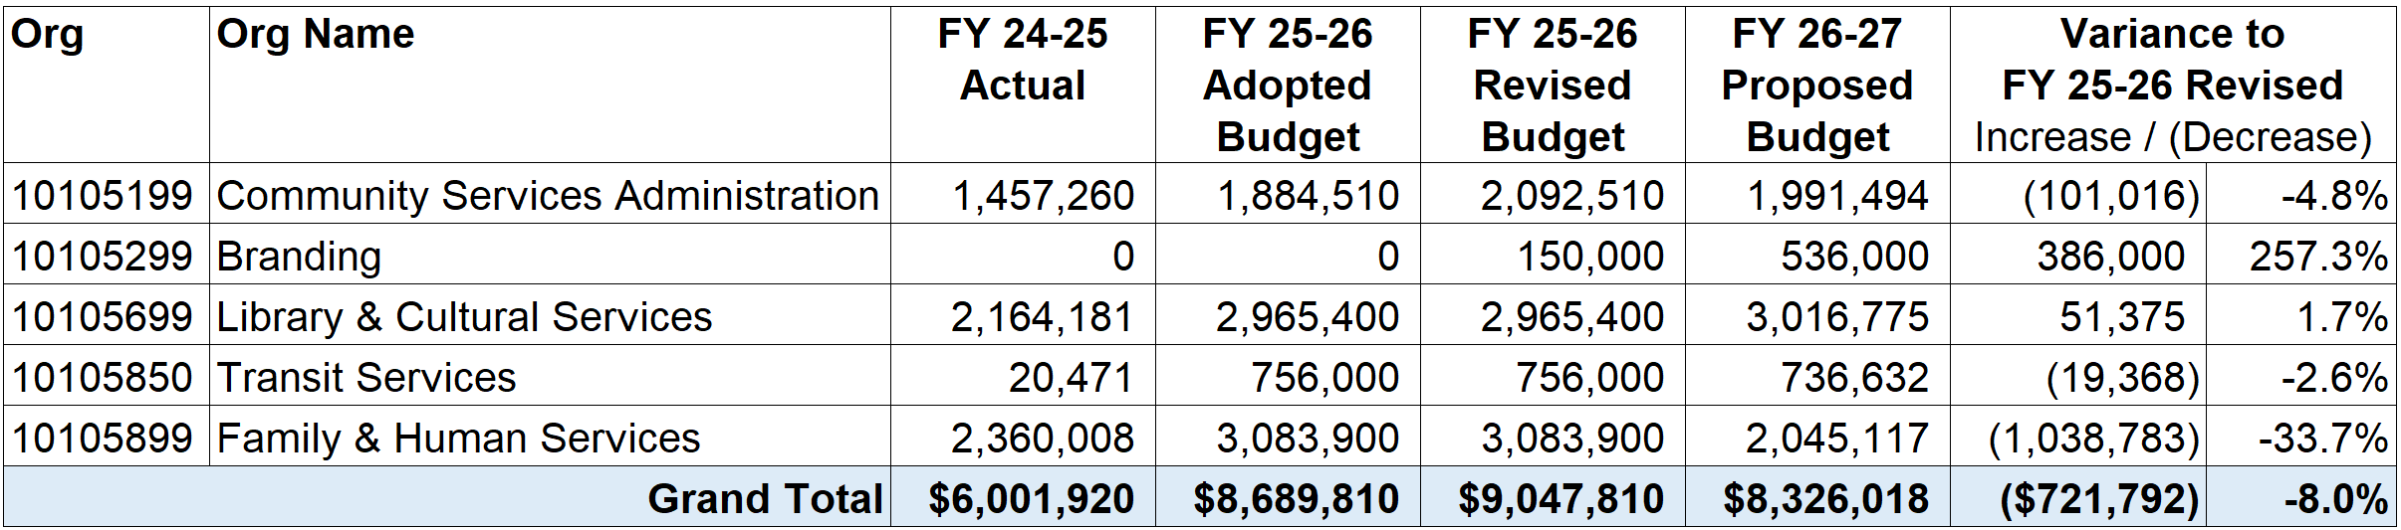
Police and Community Services
Community Services
Division
Proposed Budget Summary – Community Services Division

Slide 60
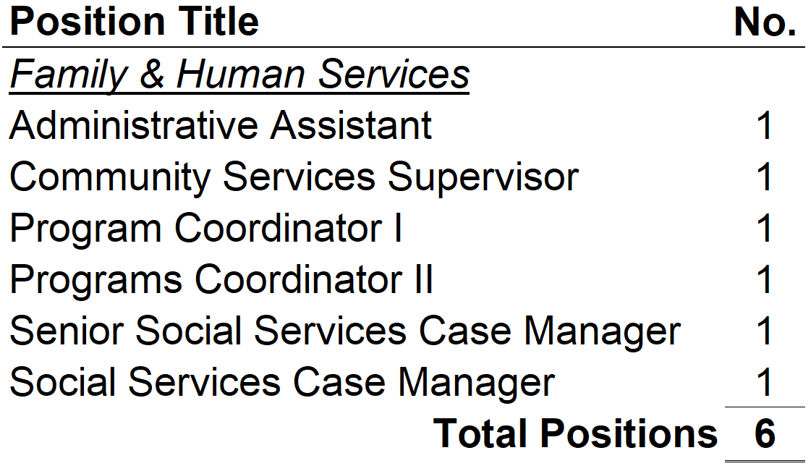
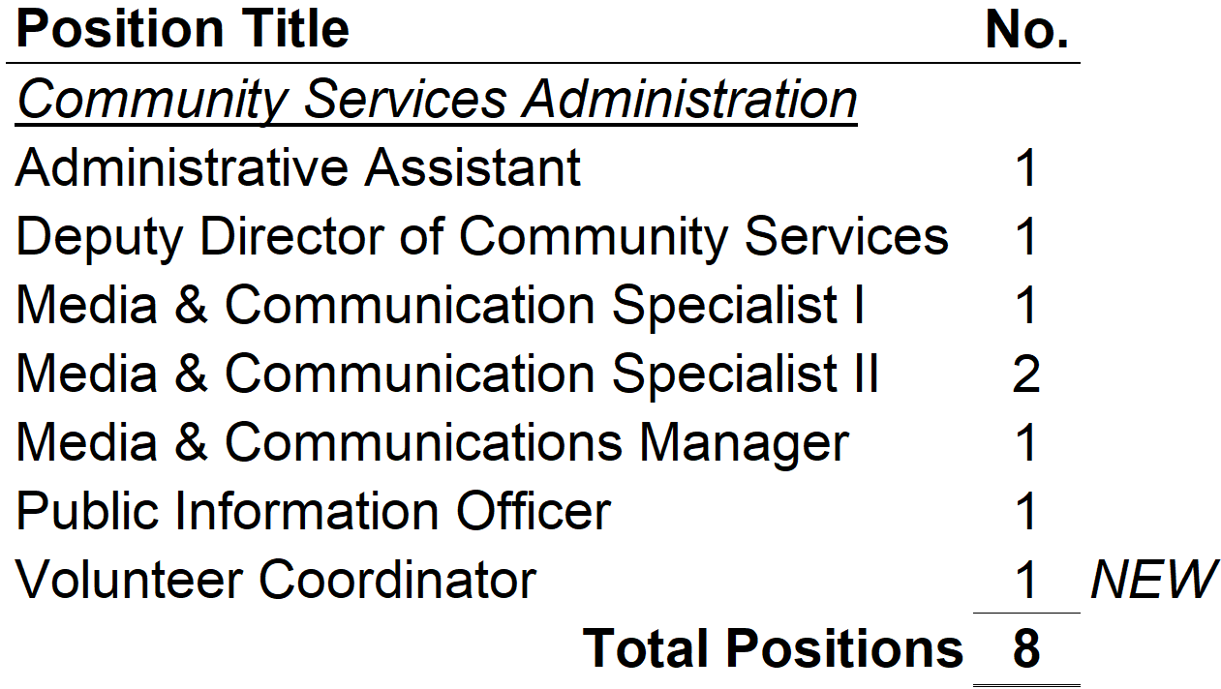
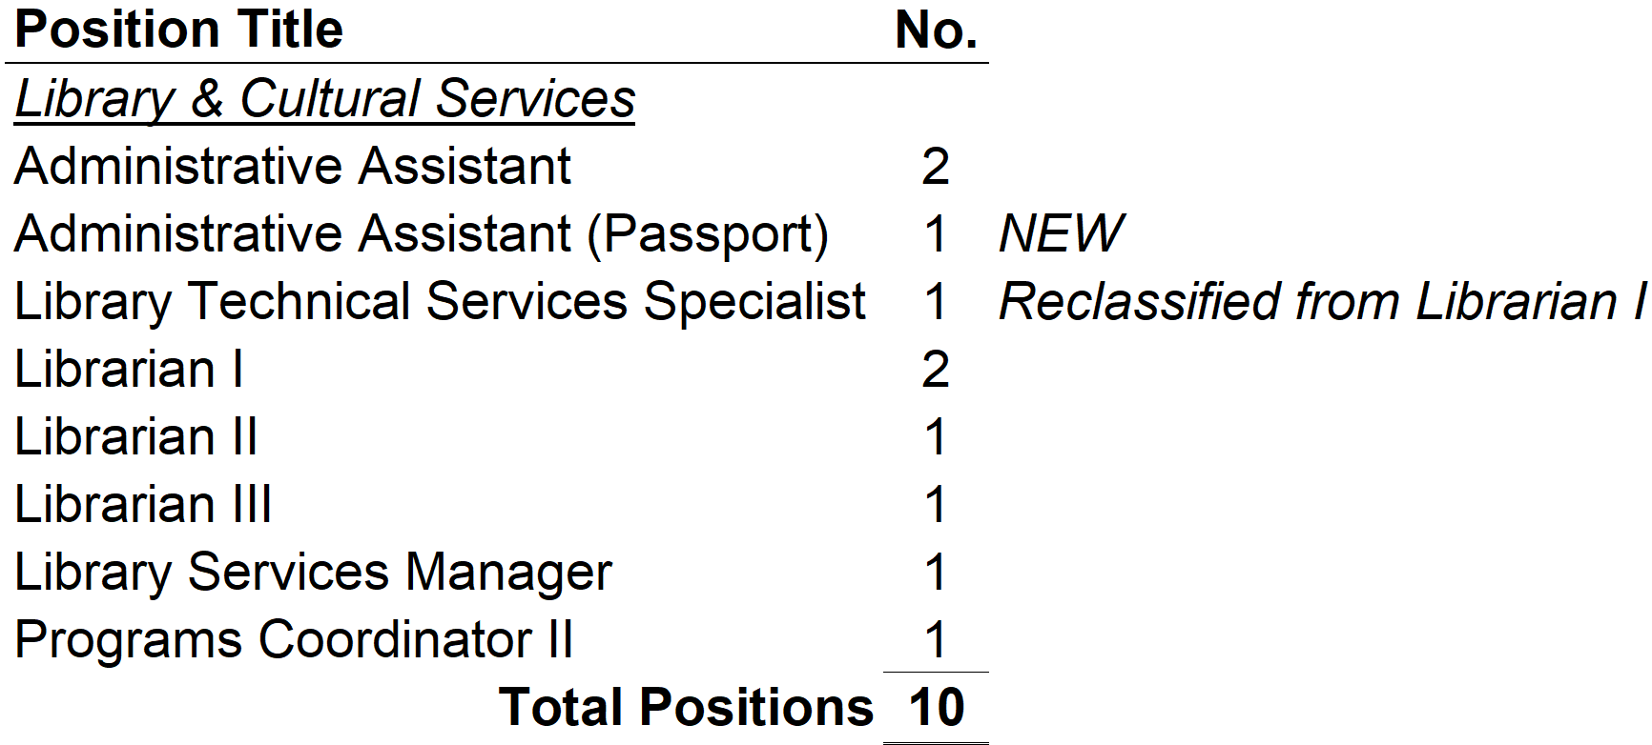
Police and Community Services
Community Services
Division
Full-Time Positions

Slide 61
Police and Community Services
Community Services
Division
Part-Time Positions

Slide 62
Police and Community Services
Community Services
Division
New and 1-time requests
Added Volunteer Coordinator position; expanded court-ordered Volunteer Program
Added Administrative Assistant position to support Passport Services
Continued implementation of Citywide Branding initiatives (Year Two)
Added (2) Social Worker Interns
Extended operating hours at the Gus Velasco Neighborhood Center to accommodate senior, community and family programming including excursions and evening dances
Added funding for activation of Betty Wilson Center for City programs and activities
Added funding to enhance Library services, including Passport Services, Maker Space, Memory Lab, historical archiving of documents and display material

Slide 63
Public Works
Engineering

Slide 64
Public Works Engineering
Proposed Budget Summary
Note: Building Regulation expenses (Transtech) are partially offset by fees

Slide 65
Public Works Engineering
Full-Time Positions

Slide 66
Public Works Engineering
Part-Time Positions

Slide 67
Public Works Engineering
New and 1-time requests
Increased professional engineering services
Increased plan check services (offset by increased fees collected)

Slide 68
Public Works
Maintenance

Slide 69
Public Works Maintenance
Proposed Budget Summary
Note: Traffic – Contract Cities expenses are partially offset by revenues

Slide 70
Public Works Maintenance
Full-Time Positions

Slide 71
Public Works Maintenance
Part-Time Positions

Slide 72
Public Works Maintenance
New and 1-time requests
Increased wading pool maintenance and repairs (partially offset by reduced O/T)
Increased equipment maintenance due to aging fleet
Increased fuel cost
Increased Tree Maintenance Contract
Increased Landscape Maintenance Contract

Slide 73
Conclusion

Slide 74
Budget Development Calendar
April 6-7: | City Manager Meetings with Departments
April 23: | Budget Workshop: General Fund
May 21: | Budget Workshop: Special Funds, Capital
June 4: | City Council Budget Review and Adoption

Slide 75

QUESTIONS?

